Slide 1
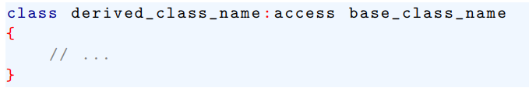
Inheritance
Base class access Control
When one class inherits another, it uses this general form:
Here access is one of three keywords: public, private or protected

Slide 2
Inheritance
Base class access Control
When the access specifier for the inherited base class is public, all public members of the base class become public members of the derived class.
If the access specifier is private, all public members of the base class become private member of the derived class.

Slide 3
Inheritance
Base class access Control
In either case, any private members of the base class remain private to it and are inaccessible by the derived class.
Technically access is optional, If the specifier is not present, it is private by default it derived class is a class.

Slide 4

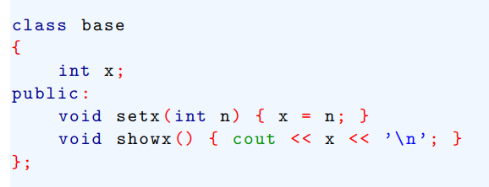
Inheritance
Base class access Control

Slide 5
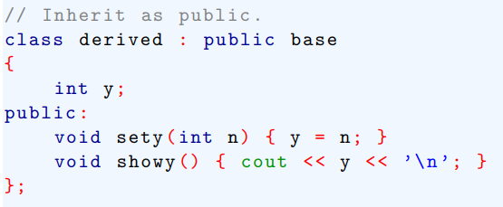
Inheritance
Base class access Control

Slide 6
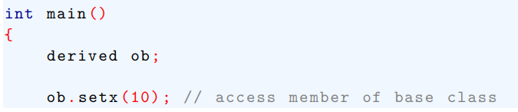
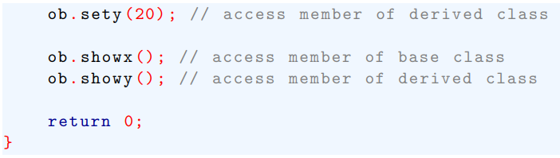
Inheritance
Base class access Control

Slide 7
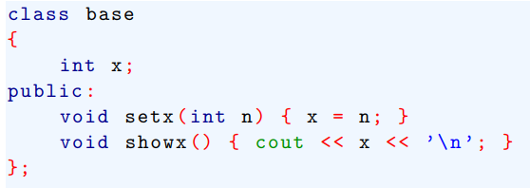
Inheritance
Base class access Control
When a derived class inherits a base as public, it does not mean that derived class has access to the base’s private members. For example, the preceding example is incorrect.

Slide 8
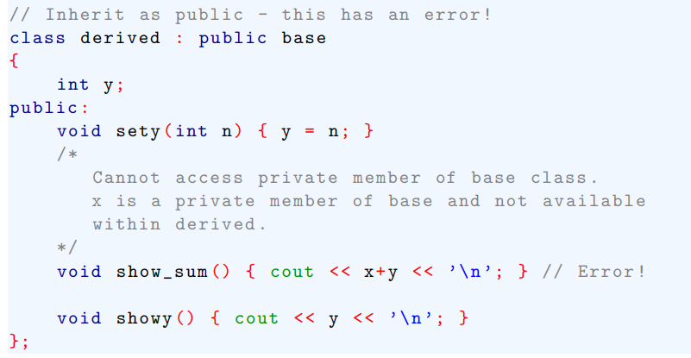
Inheritance

Slide 9

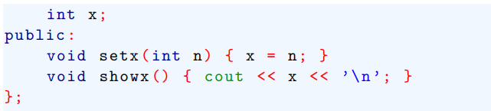
Inheritance
Here is a variation of the program shown in the above example; this time derived inherits base as private. This change causes the program to be error.

Slide 10
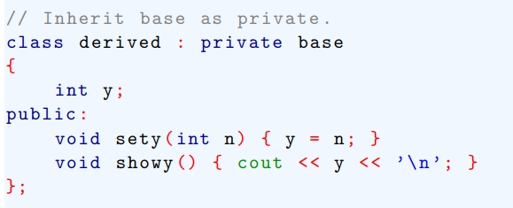
Inheritance

Slide 11
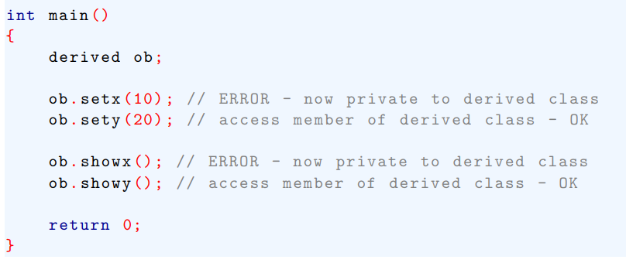
Inheritance

Slide 12
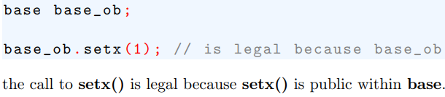
Inheritance

Slide 13


Inheritance
As stated, even though public members of a base class become a private members of a derived class using the private member specifier, they still accessible within the derived class.

Slide 14
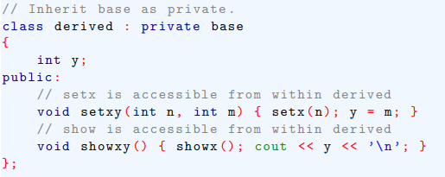
Inheritance

Slide 15
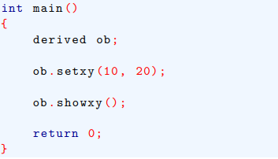
Inheritance

Slide 16
Using Protected members
As we know from preceding section, a derived class does not have access to the private member of the base class.
To accomplish this goal, C++ includes the protected access specifier.
The protected access specifier is equivalent to the private specifier with the sole exception that protected member of the base class are accessible to members of any class derived from that base.
Outside the base or derived classes, protected members are not accessible.

Slide 17
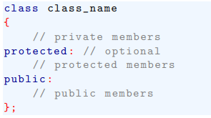
Inheritance
The full general form of a class declaration is shown here:

Slide 18
Inheritance

Slide 19

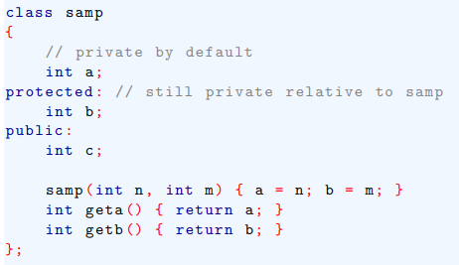
Inheritance

Slide 20
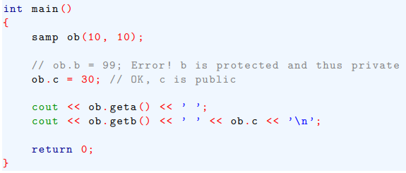
Inheritance

Slide 21
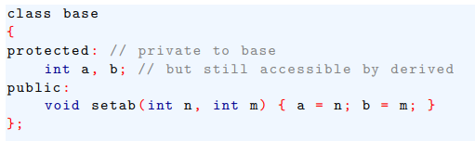
Inheritance
The following program illustrates what occurs when protected members are inherited as public.

Slide 22
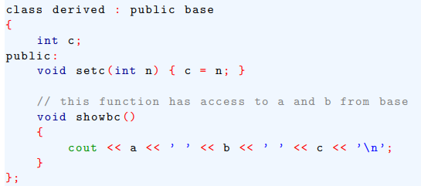
Inheritance

Slide 23
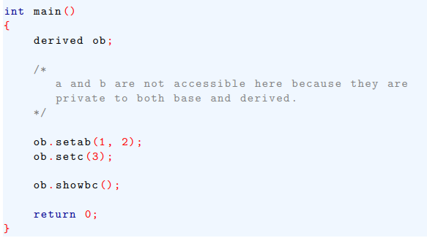
Inheritance

Slide 24
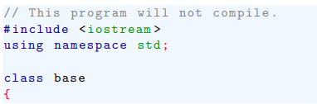
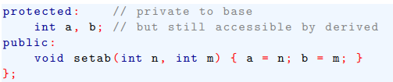
Inheritance
When a base class is inherited as protected, public and protected members of the base become protected members of the derived class.

Slide 25
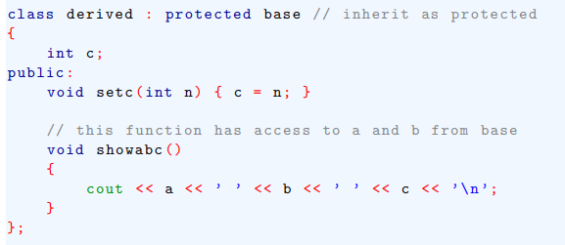
Inheritance

Slide 26
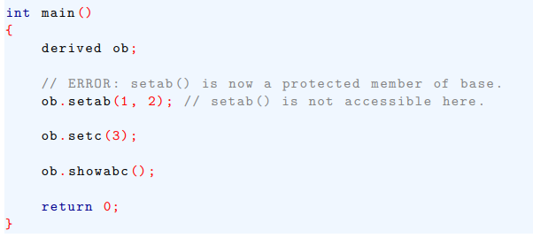
Inheritance

Slide 27
Constructors, Destructors and Inheritance
It is possible for the base class, the derived class or both to have constructor and/or destructor functions.
When a base class and a derived class both have a constructor and destructor functions, the constructor functions are executed in order of derivation.
The destructor functions are executed in reverse order.
That is, base class constructor is executed before the constructor in the derived class.

Slide 28

Constructors, Destructors and Inheritance
The syntax for passing along an argument from the derived class to the base class is shown here:

Slide 29

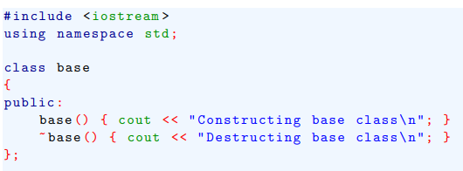
Constructors, Destructors and Inheritance

Slide 30
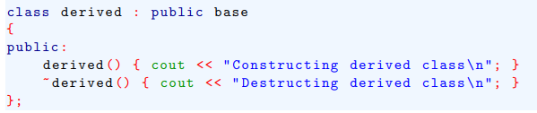
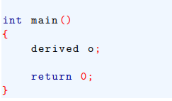
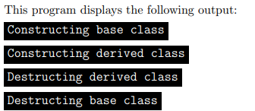
Constructors, Destructors and Inheritance

Slide 31
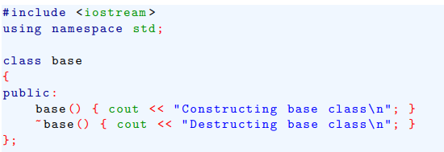
Constructors, Destructors and Inheritance
This program shows how to pass an argument to a derived class constructor

Slide 32
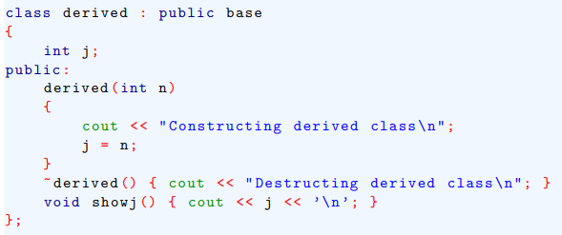
Constructors, Destructors and Inheritance

Slide 33
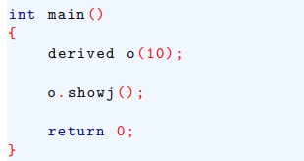
Constructors, Destructors and Inheritance

Slide 34
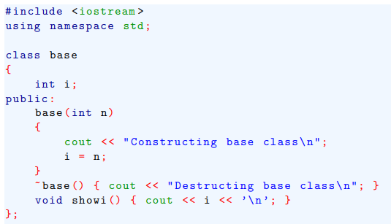
Constructors, Destructors and Inheritance
Both derived class and base class constructor take argument

Slide 35
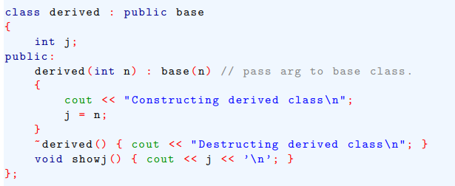
Constructors, Destructors and Inheritance

Slide 36
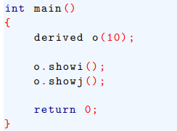
Constructors, Destructors and Inheritance

Slide 37
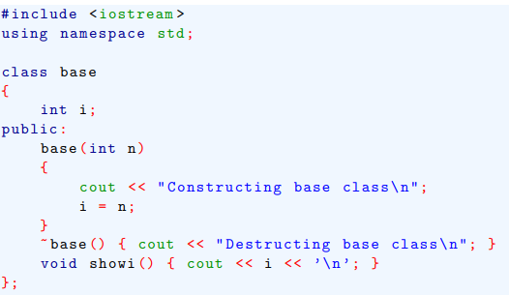
Constructors, Destructors and Inheritance
In most cases, the constructor function for the base and derived classes will not use the same argument

Slide 38
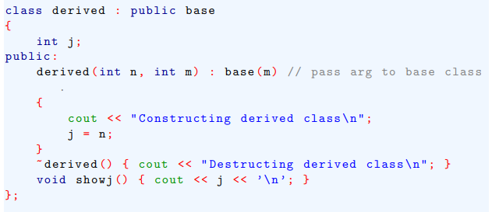
Constructors, Destructors and Inheritance

Slide 39
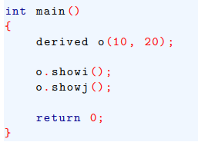
Constructors, Destructors and Inheritance

Slide 40
Multiple Inheritance
There are two ways that a derived class can inherit more than one base class.
First, a derived class can be used as a base class for another derived class, creating multilevel hierarchy.
Second, a derived class can directly inherit more than one base class.

Slide 41
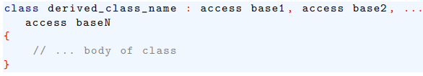

Constructors, Destructors and Inheritance
When a derived class directly inherits multiple base classes, it uses this expanded declaration:
Constructor declaration

Slide 42

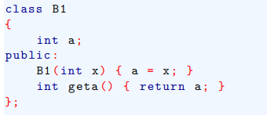
Constructors, Destructors and Inheritance

Slide 43
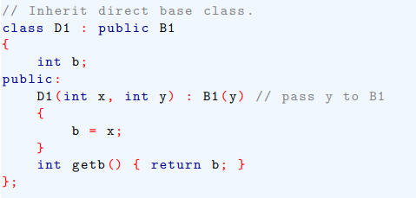
Constructors, Destructors and Inheritance

Slide 44
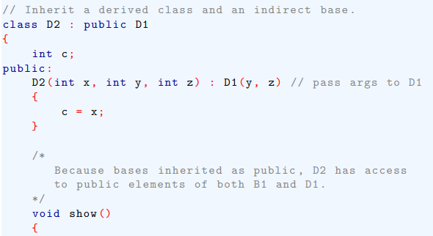

Constructors, Destructors and Inheritance

Slide 45
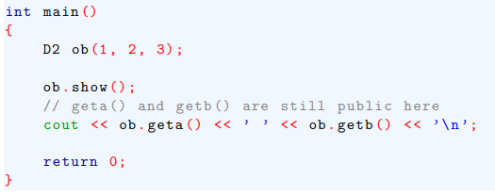
Constructors, Destructors and Inheritance

Slide 46
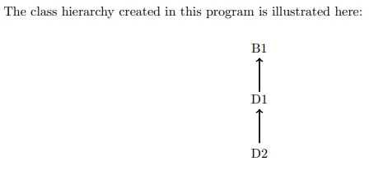
Constructors, Destructors and Inheritance

Slide 47
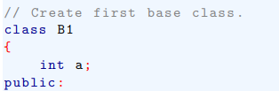

Constructors, Destructors and Inheritance
Here is a reworked version of the preceding program, in which a derived class directly inherit two base classes.

Slide 48
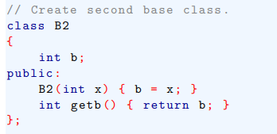
Constructors, Destructors and Inheritance

Slide 49
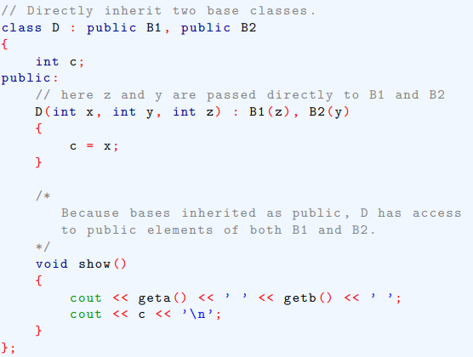
Constructors, Destructors and Inheritance

Slide 50
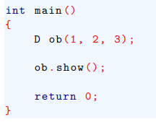
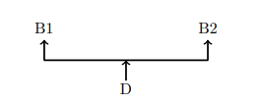
Constructors, Destructors and Inheritance

Slide 51
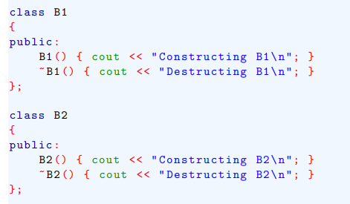
Constructors, Destructors and Inheritance

Slide 52
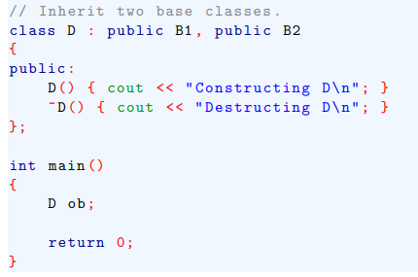
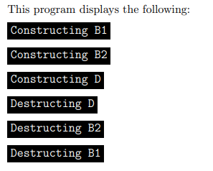
Constructors, Destructors and Inheritance

